Slide 1



Name of Project : AI Powered Groundwater Depletion And Recharge Prediction
PRESENTED BY: PRIYA KUMARI
PROJECT DOMAIN:WATER RESOUIRCE

Slide 2

Learning Objectives
Understand groundwater behavior – study factors
affecting depletion and recharge.
Data handling skills – collect, clean, and preprocess
hydrological and environmental data. Analyze historical
data for actionable insights.
AI & ML application – build predictive models for
groundwater levels.
Interpretation & visualization – analyze results to
support water resource planning.
Deployment & real-world application – implement a
tool for monitoring and prediction.
GOAL

Slide 3
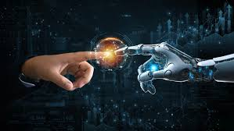
Tools and Technologies used
Programming: Python Libraries: Pandas,
NumPy, Seaborn, Matplotlib, Scikit-learn
Models: Random Forest Regressor
Metrics: RMSE, R² Score, MSE
Environment: Jupyter Notebook / VS Code
Data: Excel file
Visualization: Charts, graphs for groundwater
trends

Slide 4
Methodology
Data Import & Cleaning: Loaded rainfall & groundwater datasets from Excel (Sheet1, Sheet2,
yearly_rainfall). Removed duplicates.
Exploratory Data Analysis (EDA): Used describe() for stats summary. Plots (correlation
heatmap, pairplot, etc.) are included.
Preprocessing: Standard Scaler applied for normalization.
Model Development: Implemented Random Forest Regressor for groundwater prediction.
Model Evaluation: Calculated RMSE and R² Score to measure prediction accuracy.
Prediction: Trained the model and generated predictions for testing set.
Plot: Plot with data available.

Slide 5
Problem Statement:
Groundwater is a critical resource for drinking, agriculture, and industry, but many
regions face severe depletion due to over-extraction, population growth, and climate variability.
Traditional monitoring methods are often slow, expensive, and unable to provide accurate forecasts of water
availability or recharge patterns. This leads to inefficient water management, potential scarcity, and long-term
environmental consequences.
Need for AI-driven prediction system to forecast recharge/depletion trends.

Slide 6
Solution:
The AI-driven groundwater prediction system leverages historical data, rainfall patterns, and environmental variables to forecast groundwater depletion and potential recharge. By using machine learning models, it can:
Accurately predict periods of groundwater stress and replenishment.
Provide early warnings to help authorities and communities manage water usage.
Support optimized planning for irrigation, water harvesting, and sustainable extraction.
Supports data-driven decisions, improving efficiency over traditional methods.
Scalable and adaptable for different regions, with potential for real-time monitoring and climate
scenario integration

Slide 7
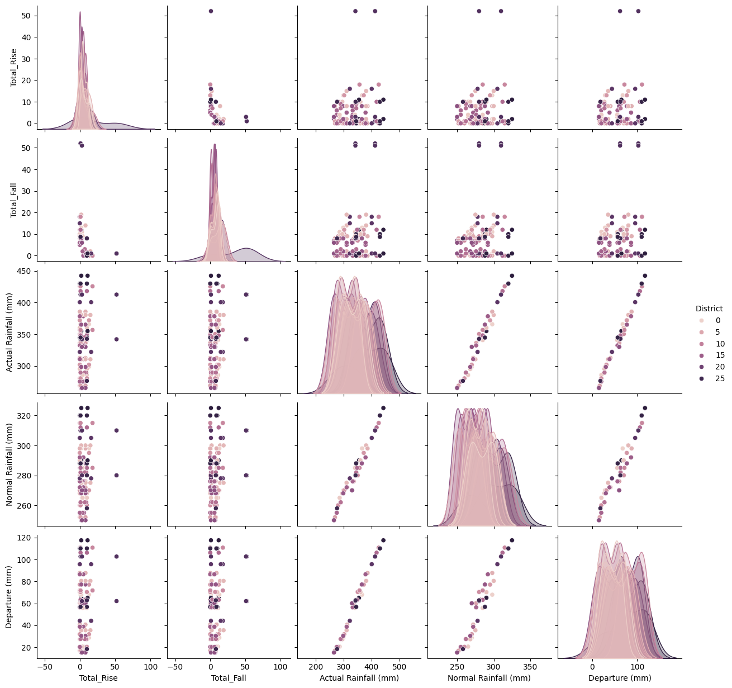
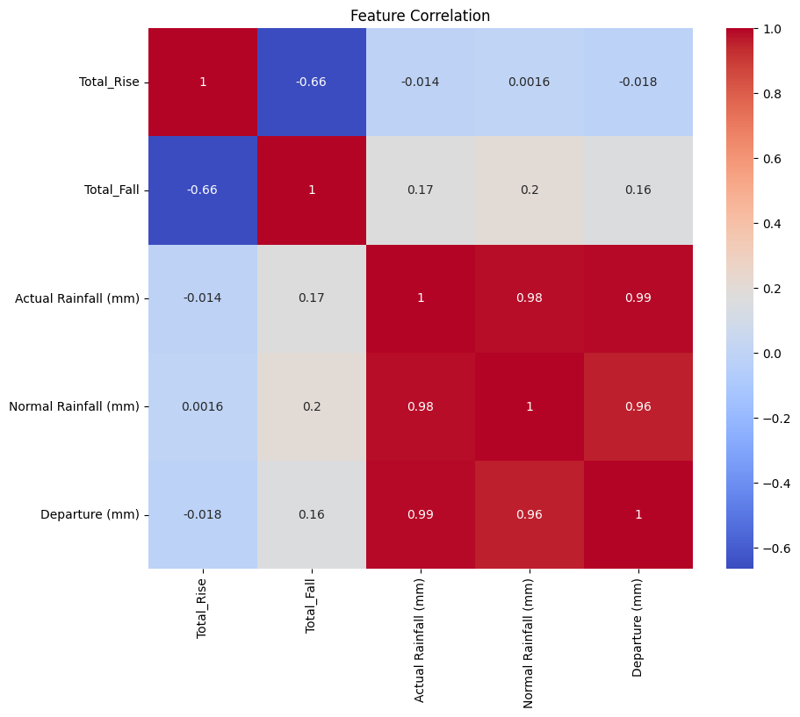
Screenshot of Output:
PAIRPLOT AND CORRELATION

Slide 8
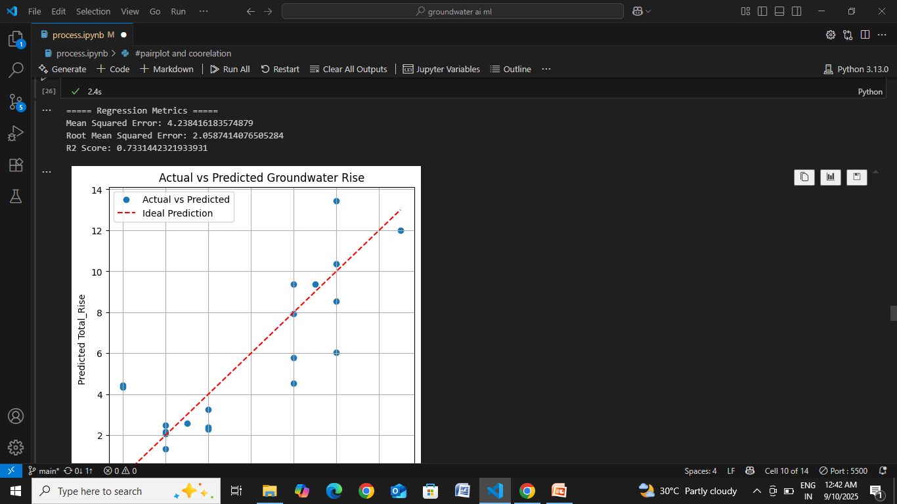
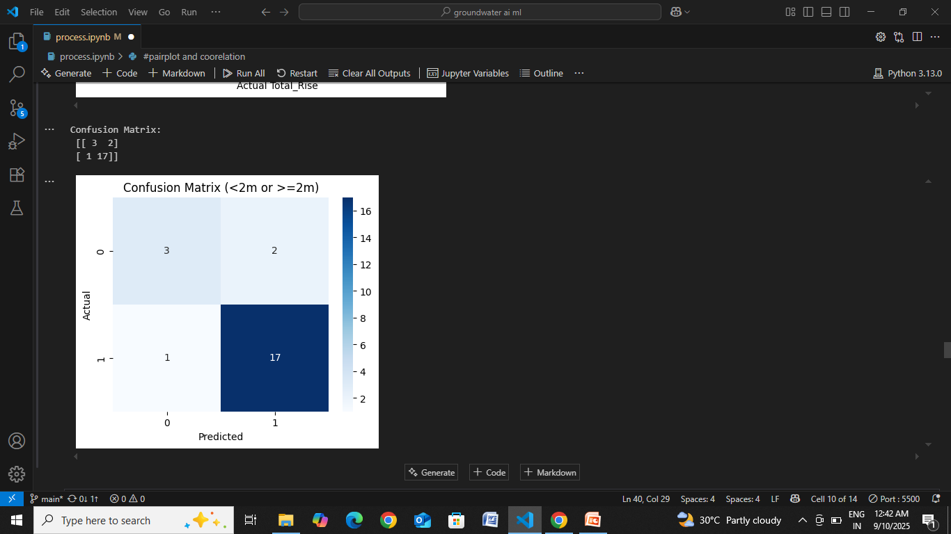
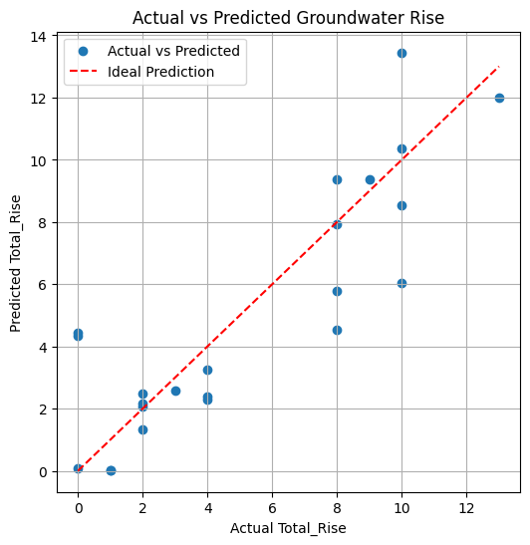
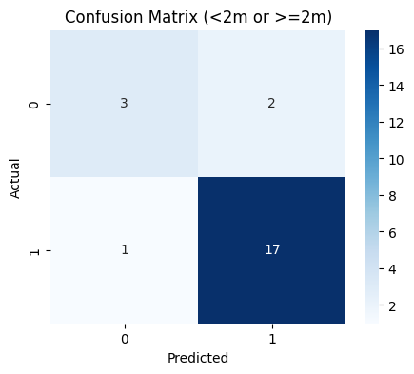

Slide 9
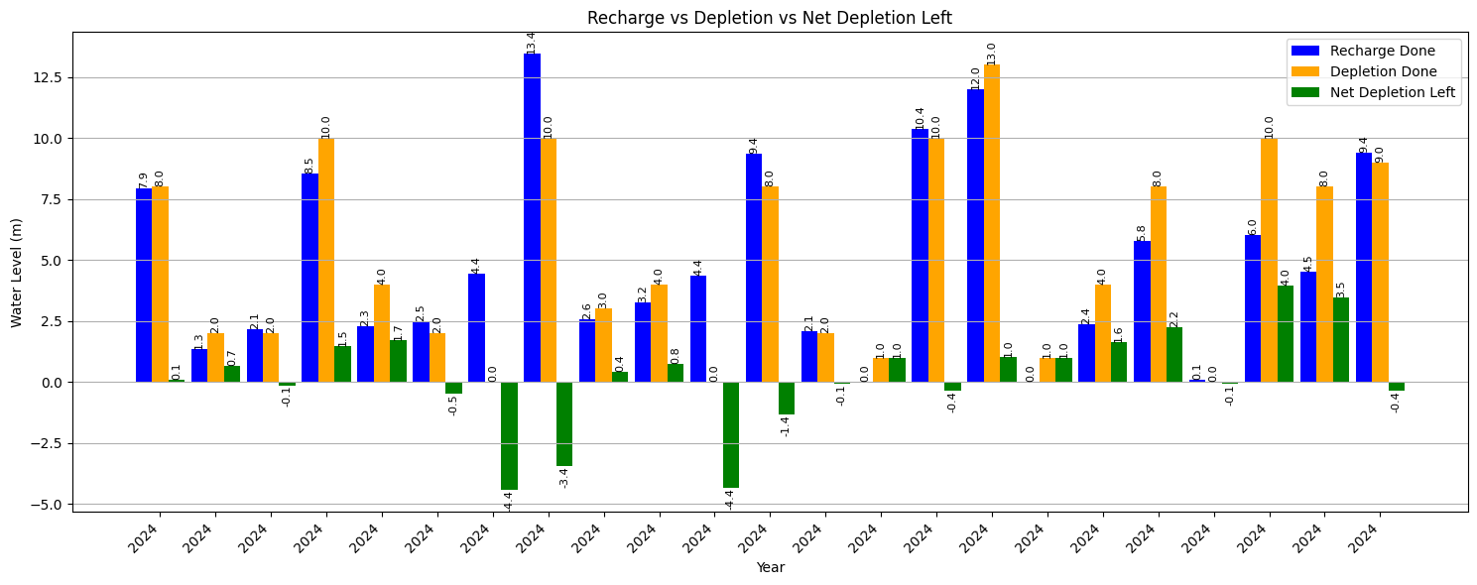
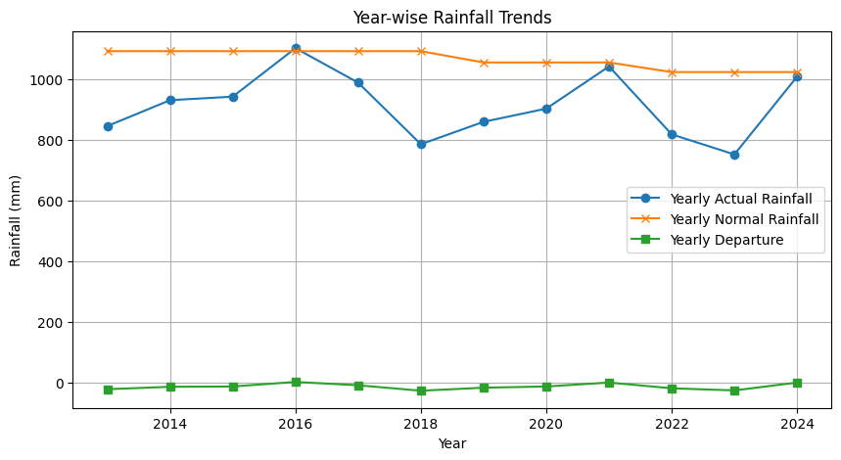

Slide 10
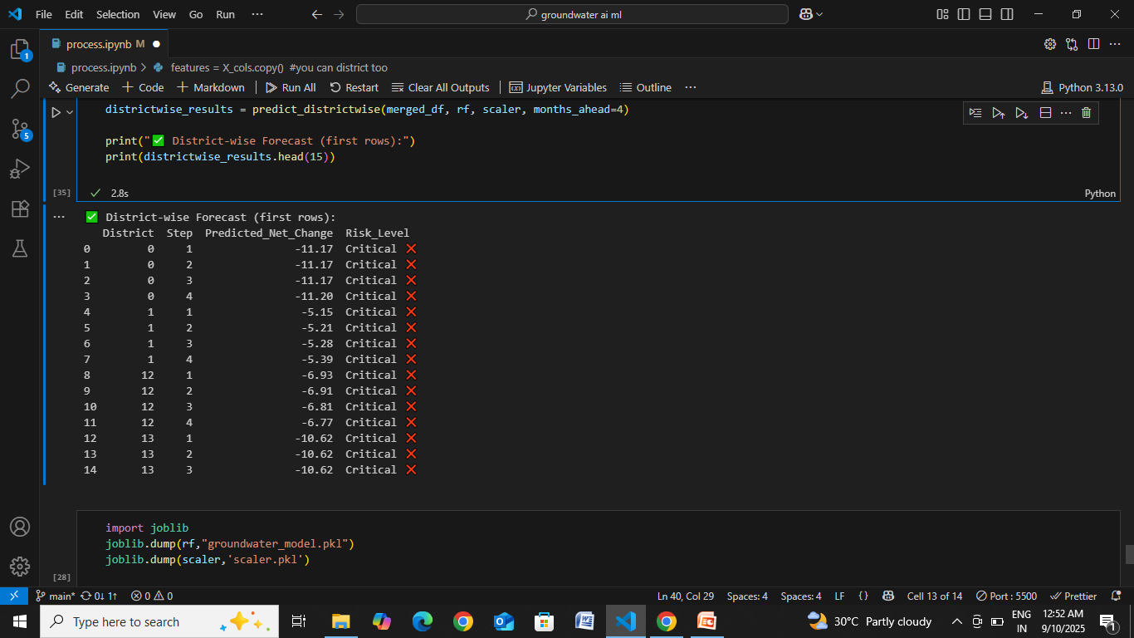
FUTURE PREDICTED NET CHANGE AND RISK LEVEL

Slide 11
Conclusion:
This project provides AI-based predictions for groundwater rise and depletion, helping users understand trends and take proactive measures for sustainable water management. The AI model accurately predicts groundwater depletion and recharge trends, aiding sustainable water management. It enables early warnings and optimized water usage for farmers and authorities. Supports data-driven decisions, improving efficiency over traditional methods. It is scalable and adaptable for different regions, with potential for real-time monitoring and climate scenario integration.

Slide 12
THANK YOU

